Slide 1


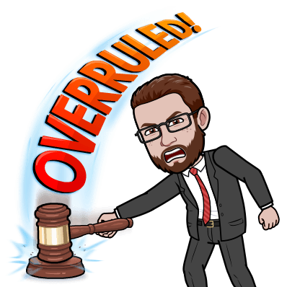
Mock Trials

Slide 2
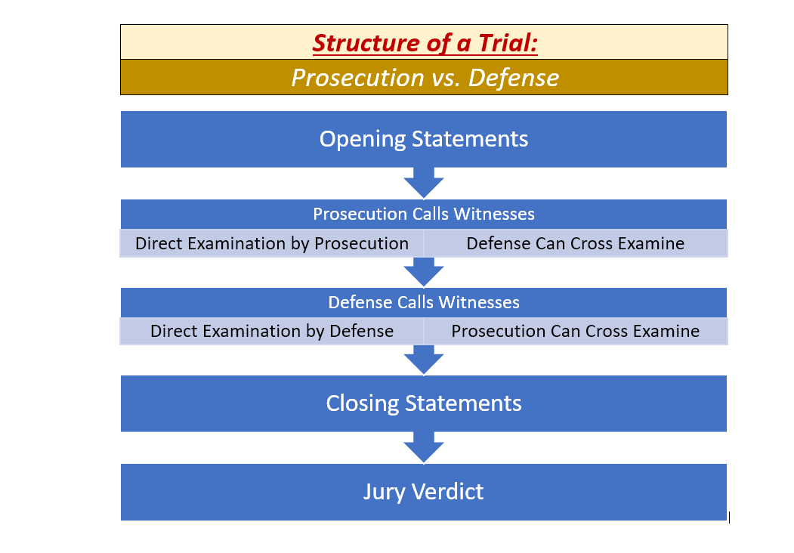
Structure of a Trial

Slide 3
OBJECTIONS
Leading Question
Speculation
Opinion
Relevance
Hearsay

Slide 4
Case 1: PEOPLE v. MATSUMOTO
Question: Did Bailey Matsumoto murder his partner, Taylor Matsumoto, in a deliberate and premeditated way?
Crime: 1st Degree Murder
To find the defendant guilty of 1st degree murder, the prosecution must prove that:
Bailey intentionally took the life of Taylor
Bailey did so in a pre-planned way
Bailey is guilty of this crime beyond any reasonable doubt

Slide 5
Case 1: PEOPLE v. MATSUMOTO
Prosecution:
Lawyer(s): Arianna
Desi Kunstler: Ezequiel
Case Silber: Ezequiel
Dr. Jules Jackson: Daniella
Det. Micah Eisenberg: Joseph
Researchers: Natalie, Gabriella
Defense:
Lawyer(s): Willie
Bailey Matsumoto (Defendant) : Stefany
Val Glick: Cole
Quinn Clampitt: Nicolas
Dr. Amari Wolpert: Gael
Researchers: Ryan

Slide 6
Case 1: PEOPLE v. MATSUMOTO
Question: Did Bailey Matsumoto murder his partner, Taylor Matsumoto, in a deliberate and premeditated way?
Crime: 1st Degree Murder
In a vote of 8-2, the jury has found the defendant, Bailey Matsumoto, GUILTY of 1st Degree Murder!

Slide 7
Case 2: STATE v. JACKSON
Question: Did Terry Jackson drive in a reckless and negligent way, resulting in the death of Jane Anderson?
Crime: Negligent Homicide
To find the defendant guilty of negligent homicide, the prosecution must prove that:
Terry behaved in reckless way, putting others at risk.
Terry failed to realize that his actions were dangerous and could have resulted in someone’s death.
Terry is guilty of this crime beyond any reasonable doubt.

Slide 8
Case 2: STATE v. JACKSON
Prosecution:
Lawyer(s): Julissa
Chris Jones: Luciano
Pat Martin: Armani
Officer Kelly Demlong: Adilen
Researchers: Christian, Glenia, Sherlyn
Defense:
Lawyer(s): Jordan
Terry Jackson (Defendant) : Brian
Shaun Anderson: Trenton
Tracy Roller: Amanda
Researchers: Isabella, Elizabeth

Slide 9
Assignment
Go to Teams and fill out the VERDICT or REFLECTION assignment for the State v. Jackson case.

Slide 10
Meme Generator
Think about what we’ve learned during the mock trial process about trials, law, and the role of lawyers and the jury.
Go to the online meme generator at https://imgflip.com/memetemplates and create a meme about this!
Post your meme on our “Maps and Images” channel on Teams, with a one sentence explanation for it.

